Slide 1
Hands-on Workshop
F-klubben
Netcompany
25-03-2019
1.0
Søren Bonderup
sbon@netcompany.com

Slide 2

Agenda
Intro (about us)
Assignment today and how to solve it
Describe roles
Describe assignments
Hands-on workshop in teams

Slide 3
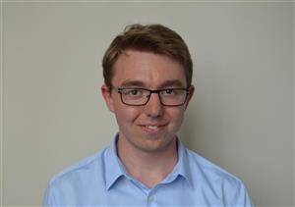
Intro | Rene
Rene Mejer Lauritsen
Consultant, Aalborg
Employment since: August, 2018
Education: Master of science in engineering software
Projects in Netcompany:
ICI – inddrivelse af skattegæld – Letter distributer
ICE – Ejendomsvurderings systemet – Letter distributer

Slide 4
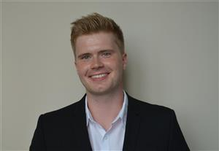
Intro | Lasse
Lasse Würtz
Consultant, Aalborg
Employment since: August, 2018
Education: Cand.Scient. Computer Science, Aalborg University
Projects in Netcompany:
ICI – Debt collection system for the danish tax administration.

Slide 5
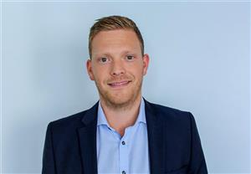
Intro | Søren
Søren Bonderup
Senior Consultant, Aalborg
Employment since: August, 2016
Education: Master of science in Vision, Graphics and Interactive Systems Aalborg University
Projects in Netcompany:
B2B e-Commerce solutions
Selfservice portals and reporting systems
Currently project lead on new order portal a teleservice provider

Slide 6
Agenda
Intro (about us)
Assignment today and how to solve it
Describe roles
Describe assignments
Hands-on workshop in teams

Slide 7
Assignment today and how to solve it
What is a normal day as a Consultant in Netcompany?
Exploration through workshop and team work
Consider what is relevant to share on the daily standup
Remember max 1-2 minutes pr. Person (standup)
Consider what is relevant to people outside the team

Slide 8
Agenda
Intro (about us)
Assignment today and how to solve it
Describe roles
Describe assignments
Hands-on workshop in teams

Slide 9

Describe roles
Project teams:
3 developers
1 architect
1 project manager

Slide 10

Describe roles | developers
Executive parts in developing solutions
Has a specific assignment
New feature
Improvement
Bug fix
Documentation
Testcases
Pull request reviews

Slide 11

Describe roles | architect
Responsible for a the overall architecture in projects
Should it be hosed in cloud or on-premise
How to integrate to other systems?
Design interfaces
Ensure high “enough” code quality
Notes:
- We need to be pragmatic in the way we think, otherwise soluitons might be thought of too much and deadlines are missed in “architectural part”

Slide 12
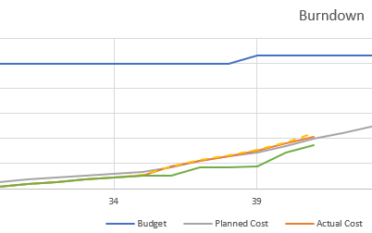
Describe roles | project manager
Shield developers from too much noice from “outside”
Assist developers with questions
Some questions can be answered others has to be forward to correct people
Assist in clarifications with customers
Ensure deadline and budget are within scope
Report to project owners and responsible committee

Slide 13
Agenda
Intro (about us)
Assignment today and how to solve it
Describe roles
Describe assignments
Hands-on workshop in teams

Slide 14
Describe assignments
We will split up in teams of 5 people
Each project participant will be given an assignment
#1: developer – pull request with new feature
#2: developer – responsible for setting up repository and pull request
#3: developer – integration to other team
#4: architect – integration to other team
#5: project manager – will ensure project are on track and report to project owner and responsible committee

Slide 15
Describe assignments |Plan
17:15 – 17:20: Get together in groups
17:20 – 17:30: Read your assignment, and prepare for daily standup in group
17:30 – 18:15: Work on you assignment
As soon as possible each group will have a daily standup. Wait for a Netcompany guy to attend (we will come to each group)

Slide 16
Agenda
Intro (about us)
Assignment today and how to solve it
Describe roles
Describe assignments
Hands-on workshop in teams

Slide 17
Hands-on workshop
As soon as possible each group will have a daily standup. Wait for a Netcompany guy to attend (we will come to each group)

Slide 18
Agenda | outro
Food break
Follow up on assignments
Presentation of points
Winner

Slide 19
Agenda | outro
Food break
Follow up on assignments
Presentation of points
Winner
Notes:
Netcompany follows up on points and participants results

Slide 20
Follow up on assignments
Was it difficult?
Are there anything you can relate to from your studies?
Was there any surprises?

Slide 21
Agenda | outro
Food break
Follow up on assignments
Presentation of points
Winner

Slide 22
Presentation of points
Team 1:
Team 2:
Team 3:
Team 4:
Team 5:
Team 6:

Slide 23
Agenda | outro
Food break
Follow up on assignments
Presentation of points
Winner

